Slide 1

Group Assigment BKAA 2013 (AUDITING AND ASSURANCE)
Shaik Ammar Yusri bin Shaik Asgar (233228)
Amirul Fitri bin Anuaruddin (233276)
Hanafi (234630)

Slide 2
Introduction
Barings was a bank founded in 1762 and was Britain’s oldest merchant bank and Queen Elizabeth’s personal bank.
Barings was the bank that fund the Napoleon Wars, Louisiana Purchase and the Erie Canal.

Slide 3
Nick Leeson
Nick Leeson was hired by Barings to profit from low risk arbitrage opportunities between derivatives contract
He was in control of the back and front office functions. Until his exploits of falsified documents and false profits that cause $1.4 billion of losses for the company found out.

Slide 4
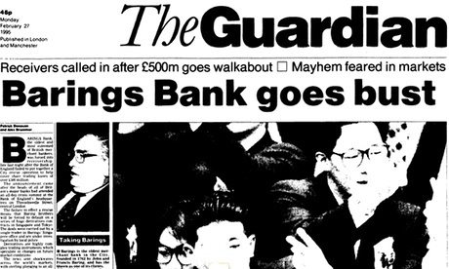

Slide 5
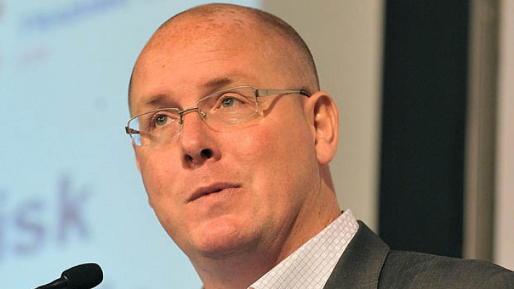
Leeson Pictured in 2011
Notes:
After released from jail, he works as a head division in Debt Advisory company, Northern Ireland, where he is supported by a team of property, accountancy, legal and banking professionals. he frequently gives speech about his “success”, and paid really well for it, 6k poundsterling.

Slide 6
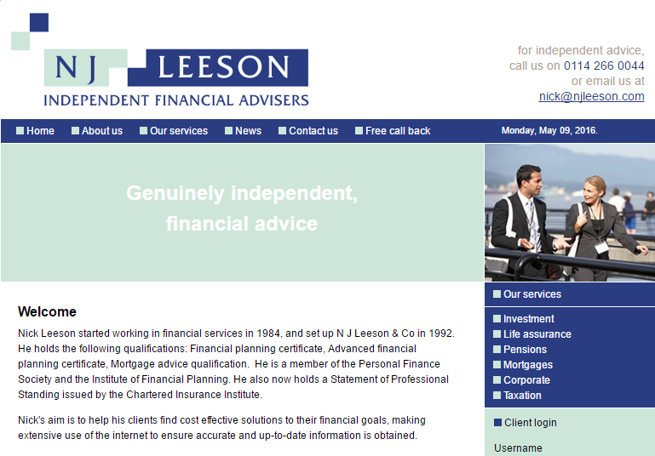

Slide 7
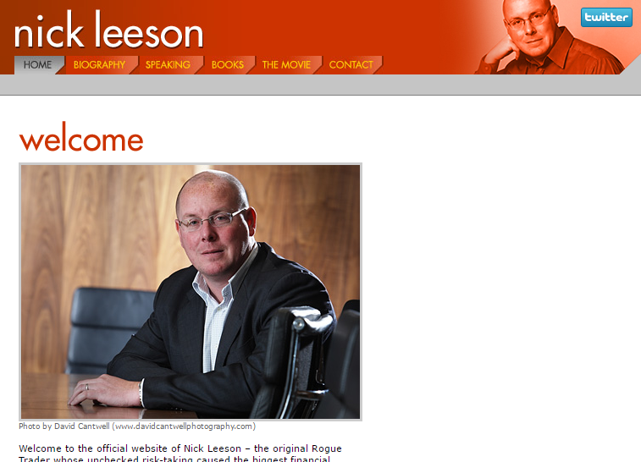

Slide 8
Question 1
What are Ethics? Generally, why do people act unethically?

Slide 9
Definition of Ethics
Ethics can be defined broadly as a set of moral principles or values. Each of us has such a set of values, although we may or may not have considered them explicitly.
Examples of prescribed sets of moral principles or values at the implementation level include laws and regulations, church doctrine, codes of business ethics for professional groups such as auditors, and codes of conduct & ethics within individual organisations.
Notes:
moral principle - The principles of right and wrong that are accepted by an individual or a social group.
values - Important and lasting beliefs or ideals shared by the members of a culture about what is good or bad and desirable or undesirable.

Slide 10
Unethical Behavior
Unethical behavior is conduct that differs from what they believe is appropriate during the circumstances.
Each of us decides for ourselves what we consider unethical behavior both for ourselves and others, because each person have their own ethical standard.

Slide 11
Unethical Behavior
There are two main reasons why people act unethically:
The person’s ethical standards are different from those of society as whole.
The person chooses to act selfishly.

Slide 12
Person’s Ethical Standards Differ From General
In this case, Lee Neson start hiding company loses and sacrifice his company well being for his personal gain, while he knew what he did was fraud, and still do it anyway.
It can be said that Neeson ethical standards differ from other.

Slide 13
The Person Chooses to Act Selfishly
When Neeson generating very unusual amount of money, Baring Bank management chose to ignore where are all the money come. Because when the company generating huge amount of profit they will get big bonus as well, which of course will benefit them.
It can be said that Baring Bank management chooses to act selfishly.

Slide 14
Question 2
Justify why is there a special need for ethical conduct in professions including those in the accounting and auditing related field ?

Slide 15
The main reason that ethical conduct is very important in accounting and auditing is threats that may occur.
The circumstances that professionals operate may create threats to compliance with the fundamental principles.

Slide 16
In reality and real life, we can take Barings Collapse as an example which Nick Leeson was encountering self-interest threat that he want to be a star trader. He tend to exploit the differences two market, and execute in the cheaper market on client orders.
Ethical conduct are vital to help auditor and accountant to maintain the integrity and objectivity, professional competence and due care, confidentiality and professional behavior.

Slide 17
Integrity and Objectivity
Members should be straight forward, honest, sincere in their approach to professional work with fair dealing and truthfulness.
In Barings case, Nick Leeson managed to gain top managements trust. He was dishonest when he decided to booked the trades with the false price where profit will be shown in the trading account.

Slide 18
Professional Competence and Due Care
Members need to improve professional services, keep professional knowledge up-to-date, and bring due care and diligence in discharging duties to clients or employers.
In Baring case, the top management are lack of knowledge and skill about the business of derivatives trading that have been done by Nick Leeson at SIMEX.

Slide 19
Confidentiality
Generally, a member acquiring or receiving any confidential information in the course of his professional work shall not use or appear to use that information for his personal advantage or the advantage of a third party.
In baring case, Nick Leeson open an error account 88888 to hide the loses for his own personal interests.

Slide 20
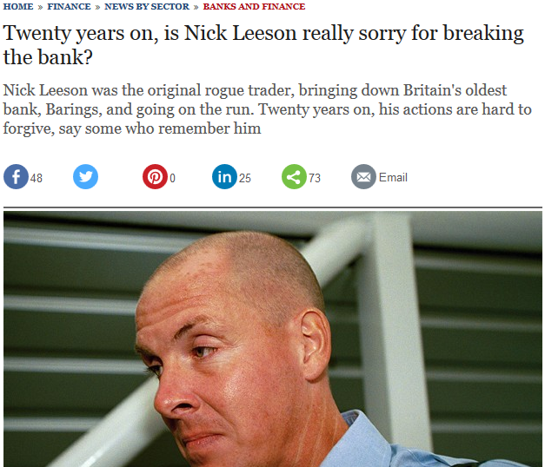

Slide 21
Professional Behavior
An obligation on professional accountants to comply with relevant laws and regulations. (Section 150)
In Baring case, there are no proper supervision towards Leeson activity. They simply approved Leesons request for extra fund to meet his margin call.

Slide 22
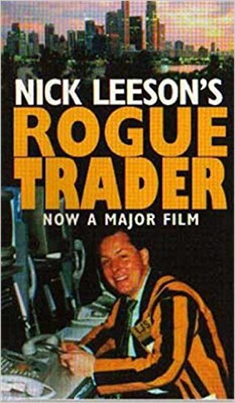
QUESTION 3
Discuss how the Barings collapse serves as an example of failed internal controls and governance within organization?

Slide 23
Inherent Limitations
Even if the internal controls are being imposed in the company, they can never be hundred percent effective because the effectiveness depends on the people who are using it.
The employee who are using it must have understanding and good experience over the procedures of the transactions or the particular transaction may go haywire.

Slide 24
Leeson was promoted to general manager with his authority lies in the trading and back office staff.
Although he holds a qualification that allow him to trade on the Singaporean Mercantile Exchange (SIMEX), he lacks the experience in the trading environment.
As a result, he suffered colossal losses and even in that position he still wildly purchased even more Nikkei futures contracts in hopes of winning back the money that he already lost and the verdict, Barings suffered $1.4 billion of losses.

Slide 25
Control Environment Management Operating Style
From Barings’s case, the bank exploits has motivated blindness in the working environment.
Barings turned blind eyes when Nick Leeson gain outstanding profit.
Barings trust him because of his ability to generate profit even if it is in a wrong way and this cause Leeson began to overvaluing outcomes

Slide 26
Management Operating Style
Management operating style enabled Leeson to continue hiding the losses since the management were lacking knowledge of what he was doing and unusual amount of Profit and Loss being generated was not given any attention and the management are happy as long as the money came in.

Slide 27
Proper Authorization of Transactions and Activities
General authorization prevent person from acquire or expend assets at will by limiting the policies in doing transactions.
Failure of Barings to do so has resulted Leeson to continue the unauthorized derivatives speculation leading to $1.4 billion hole in Barings’ balance sheet causing the bank to end its 232 years of legacy.

Slide 28
Inadequate Separation of Duties
Nick Leeson should not have hold two responsibilities at the same time. He was given the authority to control the back office as well as the front office.
He was able to manipulate things to suit his own interests since he had a lot of experience of settlements system.
If Barings separate Leeson from the front and back office duty, the collapse would not have happened. Segregation of duties is a deterrent to fraud since it requires collusion between employees to perpetrate a fraudulent act.

Slide 29
Audit Committee Participations
Having an effective audit committee can help an entity to with governance.
The absent of audit committee or an ineffective audit committee will cause the internal control and record-keeping procedures left unattended. This will expose the entity to fraudulent activities.

Slide 30
Barings should have an audit committee to maintain ongoing communications with both external and internal auditors so that things that are related to the management’s integrity can be discussed and further action can be taken to prevent the collapse.
Controls in place were inadequate means that accounts were not captured completely where the internal audit is not functioning as they should.
The presence of an effective audit committee would have help Barings since audit committee role is overseeing financial reports and their disclosure as they are independent from the entity.

Slide 31
Thank You C:

